Slide 1
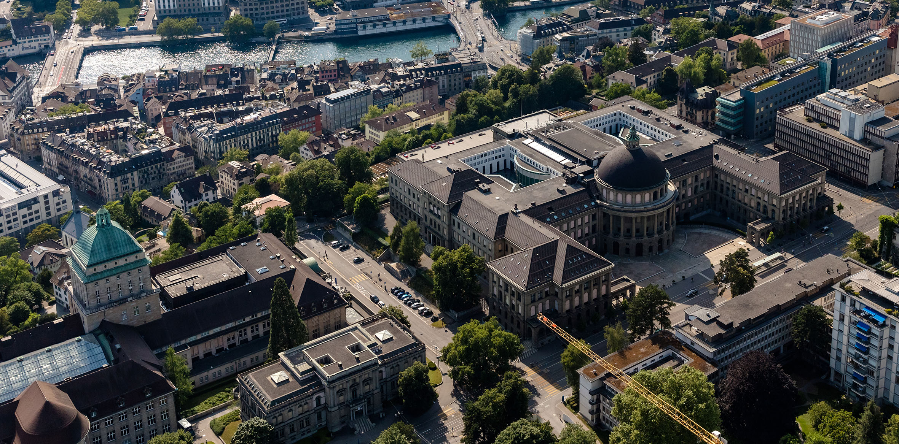
PhD Seminar
Spring Semester 2024
Dr. Daniel Barath
CVG ETH Zürich (CNB G 107.1)
dbarath@inf.ethz.ch

Slide 2
Objectives & Requirements
Objectives
Present and discuss current research being done at IVC + DRZ.
Strengthen expertise on the field.
Provide a platform for collaborationacross widely different topics researched at IVC + DRZ.
Practice scientific presentations.
Requirements
PhD students must give a 15-minutes long presentation about their research once in a semester
Have 75% presence rate
Try to give feedback to other PhD students, specially if the research is related to your own
Try to put effort on your presentations

Slide 3
PhD Seminar Format
First sessions: post-doc/senior PhDs and researchers present their research and current projects first
  Check CVG website for list and talk titles
Your presentation topic could be:
  Current project;
  Previous research;
Presentations will be 20 minutes + questions
  Two PhD students per session
  I will send an e-mail for divulgation to IVC + CGL
  Send abstract and title one week before your presentation

Slide 4
Tentative Schedule
Senior Researchers Presentations
23.02. Today – Introductory talk
01.03. Talk by Dr. Daniel Barath
08.03. Talk by Dr. Francis Engelmann
PhD Student Presentations
(will be filled when after the end of the 2nd week)
15.03.
22.03.
12.04.
19.04.
26.04.
03.05.
10.05.
17.05.
24.05.
31.05.

Slide 5
Feedbacks & Questions?

